Slide 1
MIS PROJECT PRESENTATION BY M.Karthikeyan M.Sai Rishith Reddy

Slide 2

IMAGE COMPRESSION

Slide 3
What is image compression ?
Image compression is a type of data compression applied to digital image, to reduce their cost for storage or n. Algorithms may take advantage of visual perception and the statiscal properties of image data to provide superior results compared with generic data compression methods which are used for other digital data.
Image compression may be lossy or lossless. Lossless compression is preferred for archival purposes and often for medical imaging, technical drawings, clip art, or comics. Lossy compression methods, especially when used at low bit rates, introduce compression. Lossy methods are especially suitable for natural images such as photographs in applications where minor (sometimes imperceptible) loss of fidelity is acceptable to achieve a substantial reduction in bit rate. Lossy compression that produces negligible differences may be called visually lossless.

Slide 4
Procedure for lossy image compression.
The following is a general overview of the image compressio process. Later, we will be
explaining the detailed explanation of it works mainly focusing each step by step which are
crucial in the compression stages
The image is broken into 8x8 blocks of pixels.
Working from left to right, top to bottom, the DCT is applied to each block.
Each block is compressed through quantization.
The array of compressed blocks that constitute the image is stored in a drastically reduced amount of space.
When desired, the image is reconstructed through decompression, a process that uses the Inverse Discrete Cosine Transform (IDCT).

Slide 5
Components used in compression system
(a) Source Encoder (or Linear Transformer) It is aimed at decorrelating the input signal by transforming its representation in which the set of data values is sparse, thereby compacting the information content of the signal into smaller number of coefficients. a variety of linear transforms have been developed such as Discrete Cosine Transform (DCT).
(b) Quantizer- A quantizer aims at reducing the number of bits needed to store transformed coefficients by reducing the precision of those values. Quantization performs on each individual coefficient i.e. Scalar Quantization (SQ) or it performs on a group of coefficients together i.e. Vector Quantization (VQ).
(c) Entropy Coding Entropy encoding removes redundancy by removing repeated bit patterns in the output of the Quantizer. The common entropy coders we have used in the project is the Huffman Coding.

Slide 6
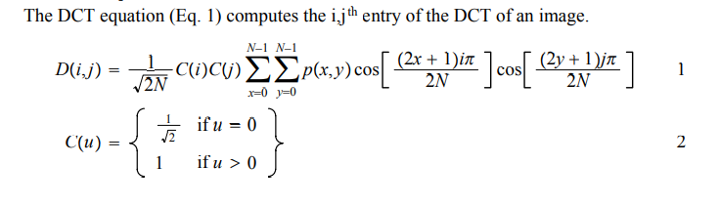
Concepts used in compression code
DCT equation:
p(x, y) is the x,yth element of the image represented by the matrix p. N is the size of the block that the DCT is done on. The equation
calculates one entry (i,jth) of the transformed image from the pixel
values of the original image matrix.

Slide 7
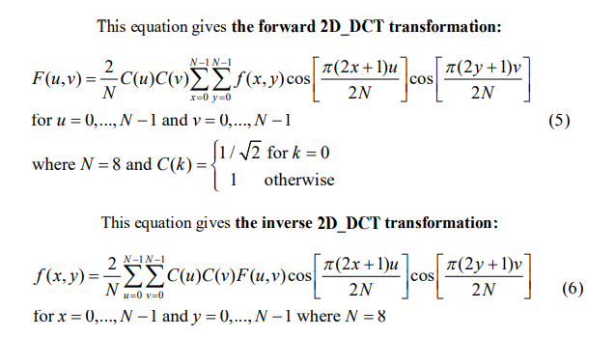
DISCRETE COSINE TRANSFORM
The next step is to divide the three colour components of the image into many 8×8 blocks. For an 8-bit image, in the original block each element falls in the range [0,255]. Data range that is centred around zero is produced after subtracting The mid-point of the range (the value 128) from each element in the original block, so that the modified range is shifted from[0,255] to [-128,127]. Images are separated into parts of different frequencies by the DCT. The quantization step discards less important frequencies and the decompression step uses the important frequencies to retrieve the image.

Slide 8

After DCT transformation, the “DC coefficient” is the element in the upper most left corresponding to (0,0) and the rest coefficients are called “AC coefficients
QUANTIZATION:
We actually throw away data through the Quantization step. We obtain the Quantization by dividing transformed image DCT matrix by the quantization matrix used . Values of the resultant matrix are then rounded off. Quantization aims at reducing most of the less important high frequency DCT coefficients to zero, the more zeros the better the image will compress. Lower frequencies are used to reconstruct the image because human eye is more sensitive to them and higher frequencies are discarded

Slide 9
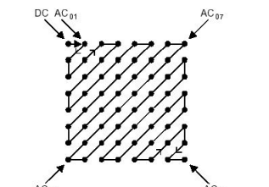
ZIG ZAG SCANNING
After quantization, the "zig-zag" scanning is done. In the "zig-zag" sequence, firstly it encodes the coefficients with lower frequencies (typically with higher values) and then the higher frequencies (typically zero or almost zero). The result is an extended sequence of similar data bytes, permitting efficient entropy encoding.

Slide 10
HUFFMANN CODING
Huffman coding is an entropy encoding algorithm used for lossless data compression. It encodes a source symbol into variable-length code which is derived in a particular way based on the estimated probability of occurrence of the source symbol.
1. Start with a list of symbols and their frequency in the alphabet.
2. Select two symbols with the lowest frequency.
3. Add their frequencies and reduce the symbols.
4. Repeat the process starting from step-2 until only two values remain.
5. The algorithm creates a prefix code for each symbol from the alphabet simply by traversing the symbols back. It assigns 0 and 1 for each frequency value in each phase

Slide 11
T1 values for dc hauffman coding
ng
size | Code length | Code word
0 | 2 | 00
1 | 3 | 010
2 | 3 | 011
3 | 3 | 100
4 | 3 | 101
5 | 3 | 110
6 | 4 | 11110
7 | 5 | 111110
8 | 6 | 1111110
9 | 7 | 111111110
10 | 8 | 1111111110
11 | 9 | 11111111110

Slide 12
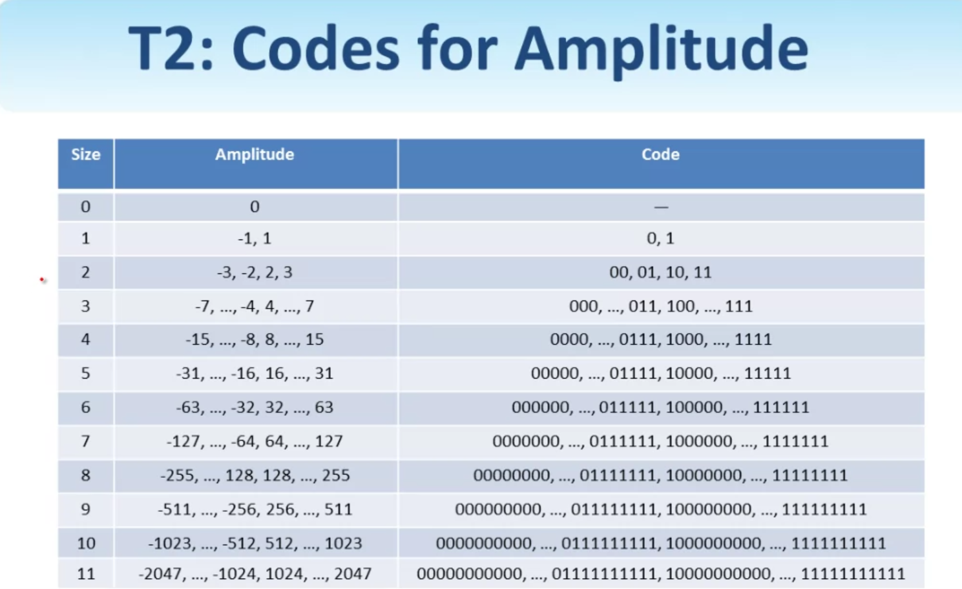
T2 : Codes for Amplitude

Slide 13
Huffmann Coding : AC Components
AC components are coded in two parts:
0Part 1(Run Length/ Size)
Run Length : The length of the consecutive zero values[0,..1,5]
Size: The number of bits needed to code the next nonzero AC component’s value.[0,-A]
(0,0) is the End of Block for the 8x8 block
Part 1 Table
Run size | Code length | Code
0/0 | 4 | 1010
0/1 | 2 | 00
0/2 | 2 | 01
0/3 | 3 | 100
0/4 | 4 | 1011
0/5 | 5 | 11010
0/6 | 7 | 1111000
0/7 | 8 | 11111000
0/8 | 10 | 1111110110
0/9 | 16 | 1111111110000010
0/A | 16 | 1111111110000011

Slide 14
Part2: (Value)
Value: is the actual value of the AC component
Run/Size | Code Length | Code
1/1 | 4 | 1100
1/2 | 5 | 11011
1/3 | 7 | 1111001
1/4 | 9 | 111110110
1/5 | 11 | 1111110110
1/6 | 16 | 111111110000100
1/7 | 16 | 111111110000101
1/8 | 16 | 111111110000110
1/9 | `16 | 111111110000111
1/A | 16 | 111111110001000

Slide 15
DECOMPRESSION
The compression phase is reversed in the decompression process, and in the opposite order. The first step is restoring the Huffman tables from the image and decompressing the Huffman tokens in the image. Next, the DCT values for each block will be the first things needed to decompress a block. The other 63 values in each block are decompressed by JPEG, filling in the appropriate number of zeros. The last step is combined of decoding the zigzag order and recreating the 8 x 8 blocks .The inverse DCT(IDCT) takes each value in the spatial domain and examines the contributions that each of the 64 frequency values make to that pixel. Reconstruction of our image begins by decoding the bit stream representing the quantized matrix C. Each element of C is then multiplied by the corresponding element of the quantization matrix originally used.
Ri, j = Qi, j × Ci, j
The IDCT is next applied to matrix R, which is rounded to the nearest integer. Finally, 128 is added to each element of that result, giving us the decompressed version N of our original 8x8 image block M.
N = round(T ‘ R T) + 128

Slide 16
Matlab Code for
Image Reading
clc;
clear all;
close all;
[file, path]=uigetfile('*.*');
I=imread(file);
figure;imshow(I);title('Original Image')
q=1;
OriginalImage=I;Q=q;
OriginalImage=double(OriginalImage);
ImageSub=OriginalImage-128;
[Row,Col]=size(OriginalImage);
BlockNumber=Row*Col/64;
Block Processing and applying DCT
Coef=blkproc(ImageSub,[8,8],'dct2(x)');

Slide 17
Quantization Matrix
L=Q*[16 11 10 16 24 40 51 61
12 12 14 19 26 58 60 55
14 13 16 24 40 57 69 56
14 17 22 29 51 87 80 62
18 22 37 56 68 109 103 77
24 35 55 64 81 104 113 92
49 64 78 87 103 121 120 101
72 92 95 98 112 100 103 99];
[CoefDCchanged,CoefAfterQ]=Quntization_pro(L,Row,Col,Coef,BlockNumber);

Slide 18
ZigZag Scanning
ImageBitSeq=[];
ImageBitLen=[];
rowloop=0;
for row=1:Row/8
colloop=0;
for col=1:Col/8
m(1:8,1:8)=CoefDCchanged((row-1)*8+1:(row-1)*8+8,(col-1)*8+1:(col-1)*8+8);
k= round(m);
ZigZag Scaning
t=zigzag(k);
Removing Extra Zeros
w=0;
u=64;
while u ~= 0
if t(u) ~= 0

Slide 19
w=u;
break;
end
u=u-1;
end
w;
if w==0
w=1;
end
e(w)=0;
for i=1:w
e(i)=t(i);
end
%e;

Slide 20
Entropy Encoding with Huffman
[blockDCbit_seq,blockDCcode_len]=DCHuffmanEncoding(e(1));
blockDCbit_seq;
blockDCcode_len;
eob_seq=dec2bin(10,4);
blockACbit_seq=[];
blockbit_seq=[];
zrl_seq=[];
trt_seq=[];
zerolen=0;
zeronumber=0;
if numel(e)==1
blockACbit_seq=[];
blockbit_seq=[blockDCbit_seq,eob_seq];
blockbit_len=length(blockbit_seq);
else
for i=2:w

Slide 21
if ( e(i)==0 & zeronumber<16)
zeronumber=zeronumber+1;
elseif (e(i)==0 & zeronumber==16);
bit_seq=dec2bin(2041,11);
zeronumber=1;
blockACbit_seq=[blockACbit_seq,bit_seq];
elseif (e(i)~=0 & zeronumber==16)
zrl_seq=dec2bin(2041,11);
amplitude=e(i);
trt_seq=ACHuffmanEncoding(0,amplitude);
bit_seq=[zrl_seq,trt_seq];
blockACbit_seq=[blockACbit_seq,bit_seq];
zeronumber=0;

Slide 22
elseif(e(i))
zerolen=zeronumber;
amplitude=e(i);
zeronumber=0;
bit_seq=ACHuffmanEncoding(zerolen,amplitude);
blockACbit_seq=[blockACbit_seq,bit_seq];
end
end
end
blockbit_seq=[blockDCbit_seq,blockACbit_seq,eob_seq];
blockbit_len=length(blockbit_seq);
blockbit_seq;
blockbit_len;

Slide 23
ImageBitSeq=[ImageBitSeq,blockbit_seq];
ImageBitLen=numel(ImageBitSeq);
colloop=colloop+1;
end
rowloop=rowloop+1;
end
ImageBitSeq;
ImageBitLen;
AverageBit=ImageBitLen/Row/Col;

Slide 24
Parameter Calculation
CoefInverseQ=blkproc(CoefAfterQ,[8,8],'x.*P1',L);
ImageSubRecon=blkproc(CoefInverseQ,[8,8],'idct2(x)');
ReconImage=round(ImageSubRecon)+128;
CR=Row*Col*8/ImageBitLen;
PSNR = PSNR(ReconImage,OriginalImage);
Output Paramters
figure;imshow(uint8(ReconImage));title('Reconstructed Image')
fprintf('Compression ratio is = %f\n',ceil(CR))
fprintf('Peak Signal to Noise ratio is = %f\n',ceil(PSNR))
fprintf('Average Bit per Pixel = %f\n',AverageBit)
imwrite(uint8(ReconImage),'rec.jpg')

Slide 25
Conclusion
Compression can be achieved by using DCT techniques that divide the image into different frequency components. The unnecessary information can then be removed from the image by quantization. This means that DCT plays a vital role in JPEG image compression. As the compression ratio is getting bigger and bigger, more and more information. Therefore, the need to introduce high efficiency DCT algorithm to achieve better image compression.

